Slide 1
Nitrogen -
Keep it in the cycle
Annemarie v d Merwe
Dr J Labuschagne
E Smit
M Booyse
28 September 2023

Slide 2


Nitrogen -Keep it in the cycle
N₂O
NO⁻₃
NO₂
NH⁺₄
NO₂
NH₃
NO
NO⁻₃
N₂O

Slide 3
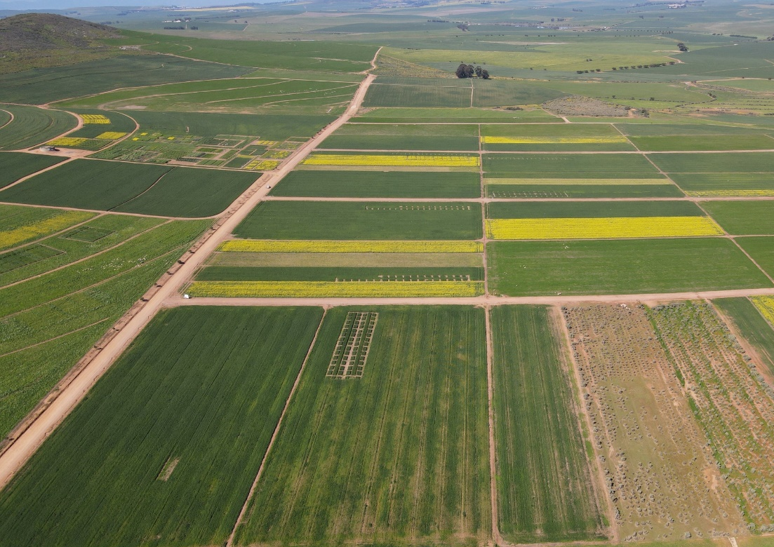
Overview
Background
Nitrogen cycle
Trial 1
Trial 2
Farmers perspective
Conclusion

Slide 4
Background

Slide 5
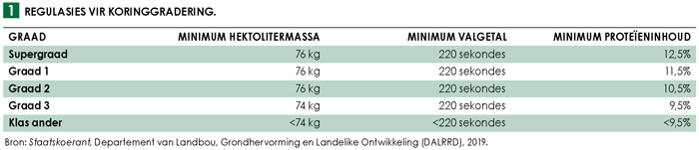
Background
Increasing demand for grain
Minimum environmental impact
Western Cape produces 42-50% of wheat in RSA
Increasing N fertiliser to boost production is non-linear
N influence yield & protein % in grain
Price determination on grain quality

Slide 6
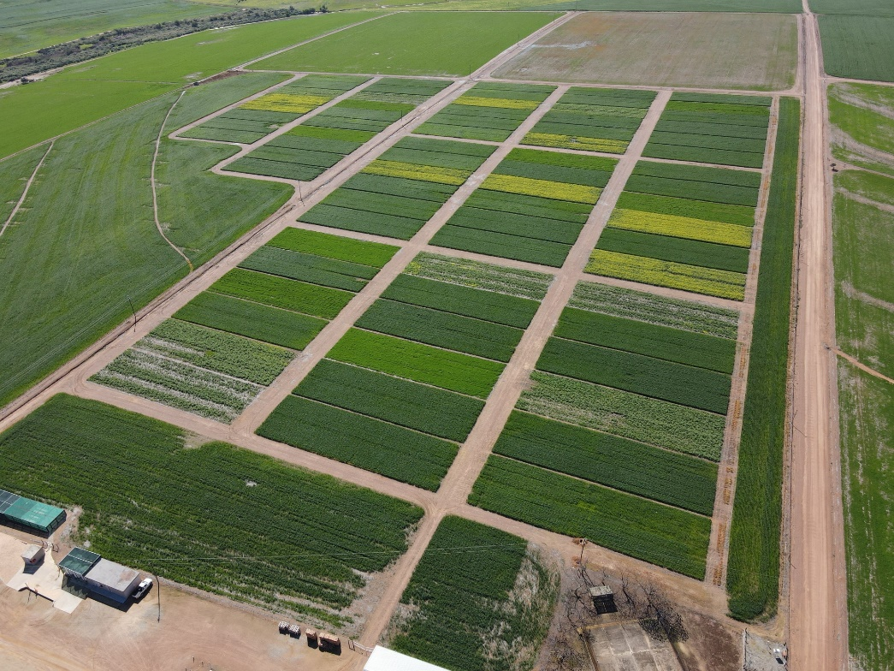
Background
80% Adoption by of CA by Western Cape farmers
Reduced tillage, crop rotation & stubble retention
Soil dynamics changed
Regenerative agriculture
  Integrate livestock
  Minimise chemical inputs
  Increase biodiversity

Slide 7
Background
Mediterranean climate

Slide 8
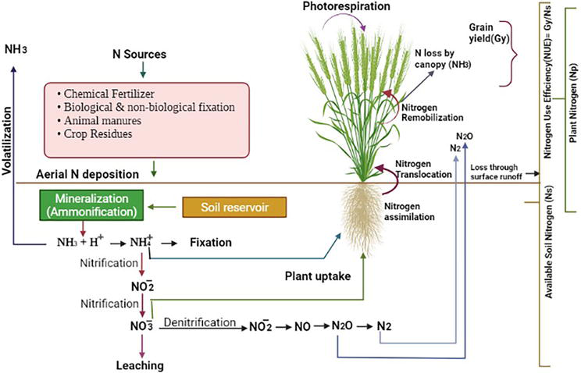
Nitrogen Cycle

Slide 9
Nitrogen use efficiency (NUE)
NUE 33%-47% for wheat
Inefficient N use
    greenhouse gas emissions,
    soil acidity
    high salt index unwanted for soil biology
Crop-based N budget
Difference between the N inputs to the system and the N removed in crop yield
Yield/fertiliser, Uptake/fertiliser or yield / uptake
Same for soil system

Slide 10
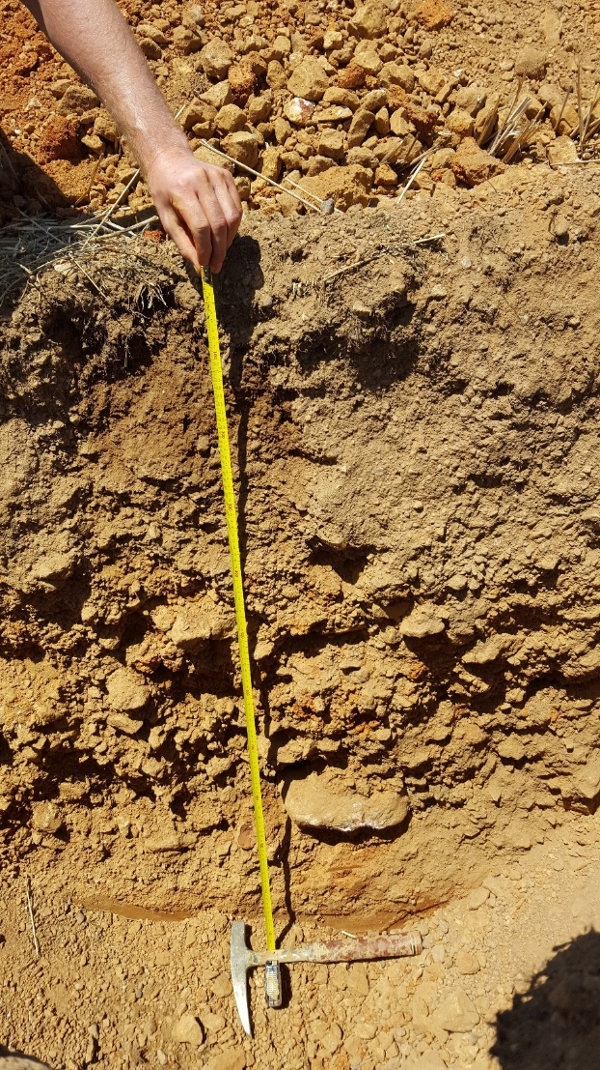
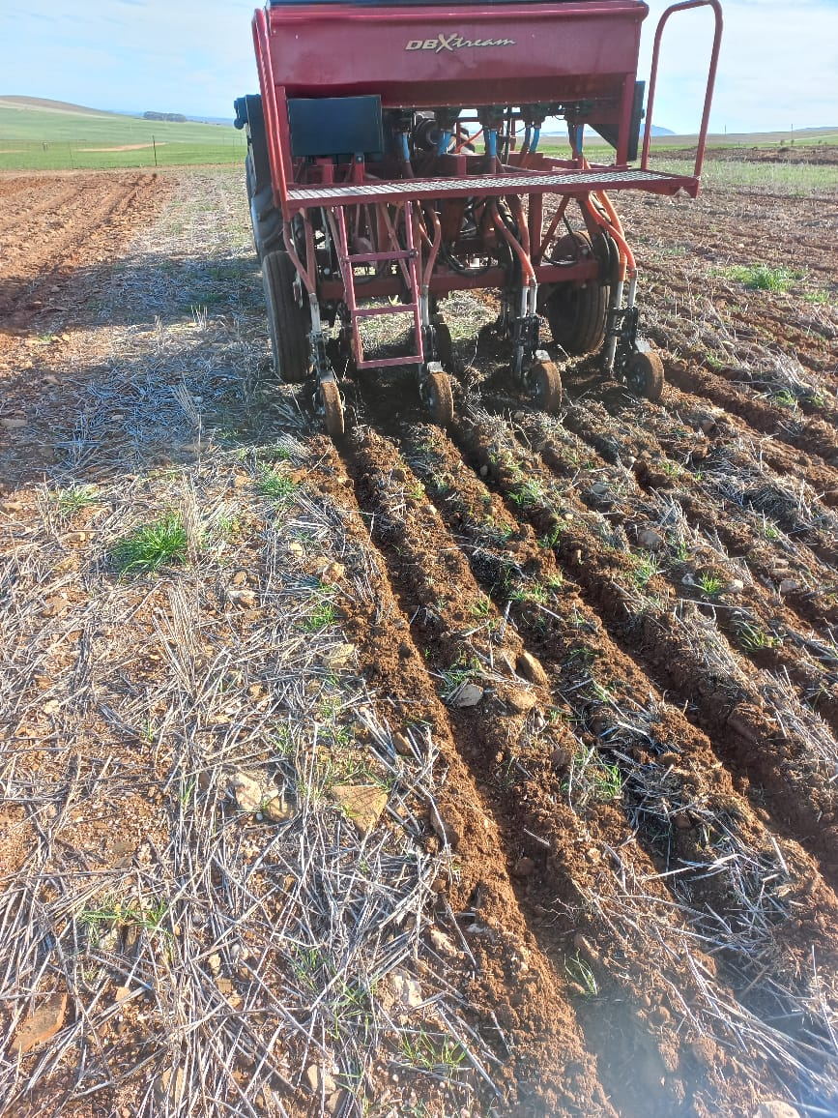
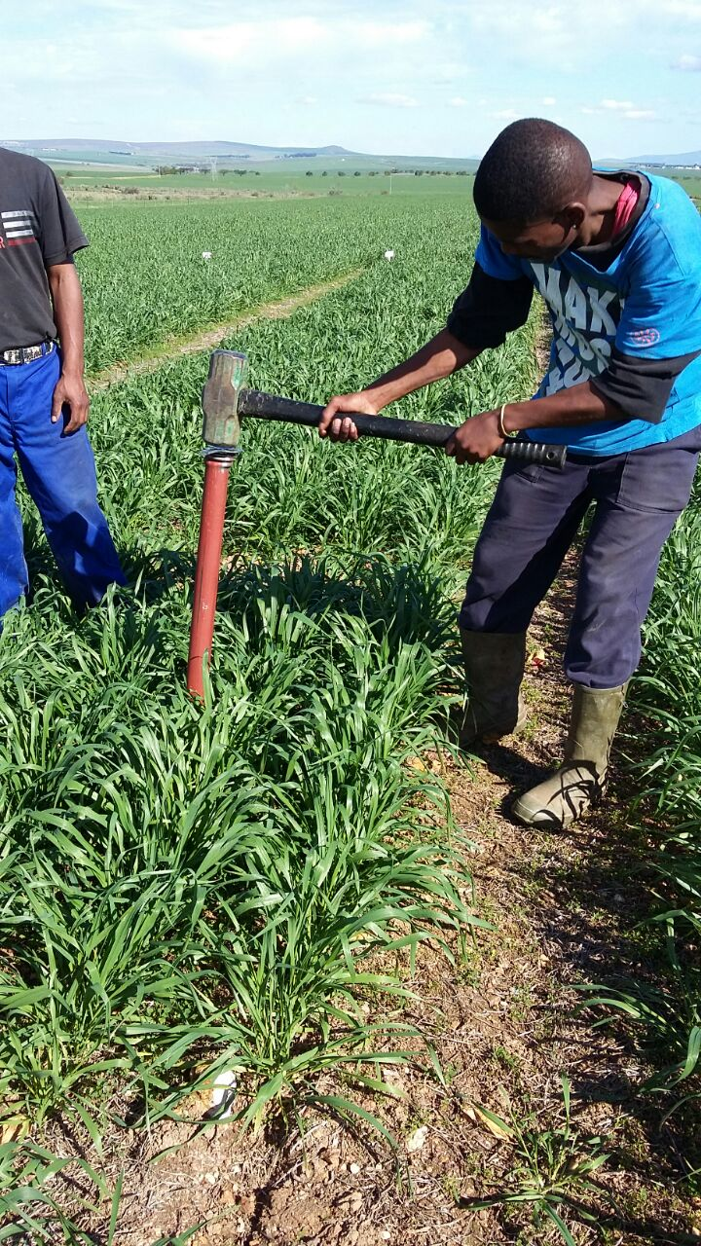
Trial 1: Nitrogen trial, 6 localities

Slide 11
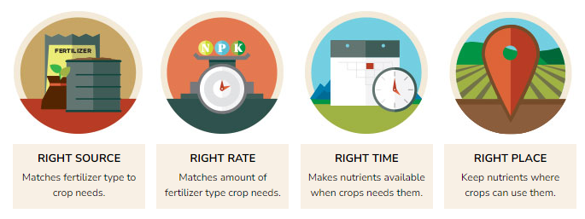
Nitrogen trial
4 R principles –source, rate, time, place
Nitrogen rates 0, 25, 50, 75, 100, 130, 160, 190 kg ha⁻¹
5 Nitrogen fertiliser sources
Exclude S effect in soil- 300 kg ha⁻¹ gypsum

Slide 12
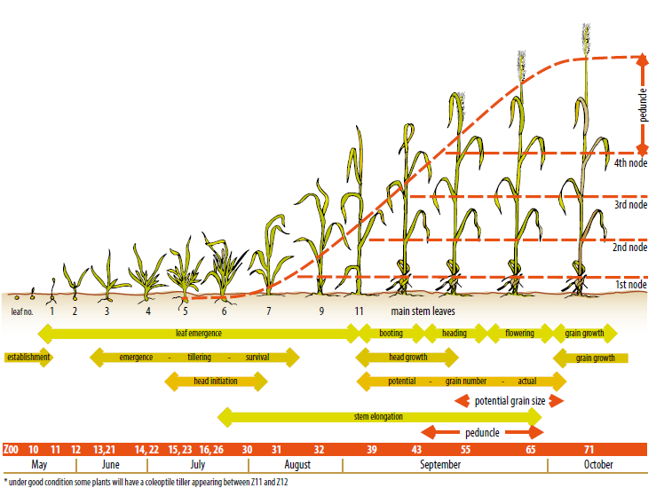
Soil samples & N fertiliser treatments
Life cycle of the wheat plant (Stapper, 2007)

Slide 13
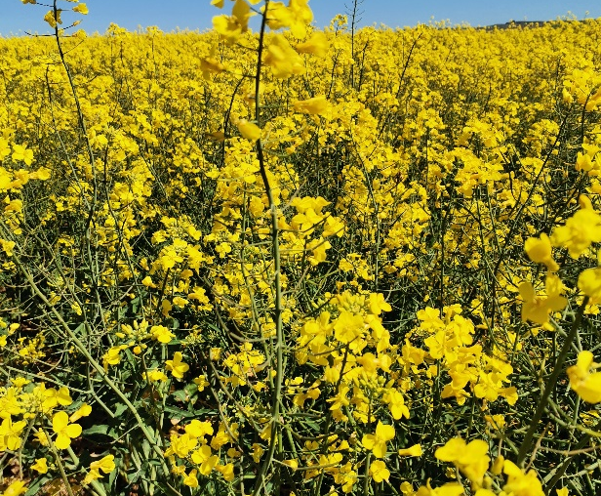
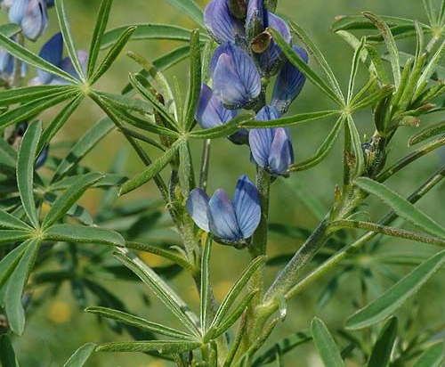
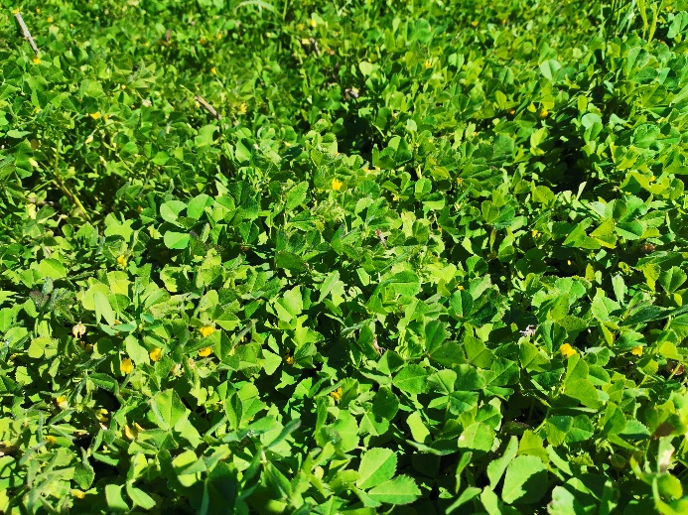
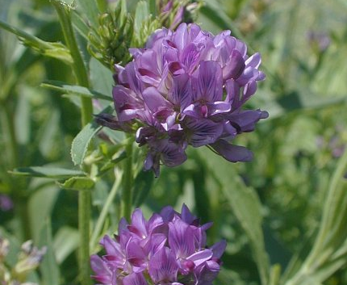
Systems
Canola-wheat
Lupine-wheat
Medics-wheat
Lucerne-wheat

Slide 14
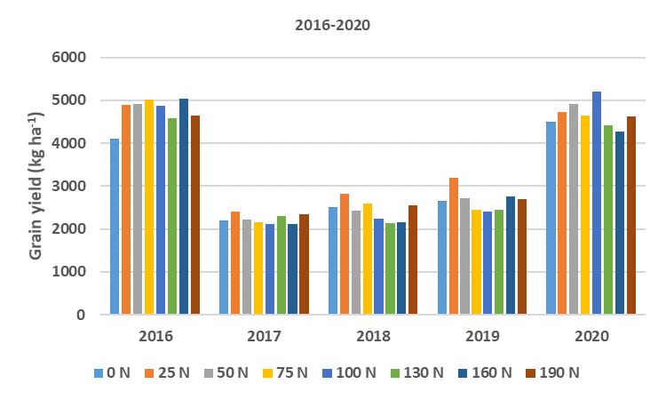
Grain yield Wheat after medics

Slide 15
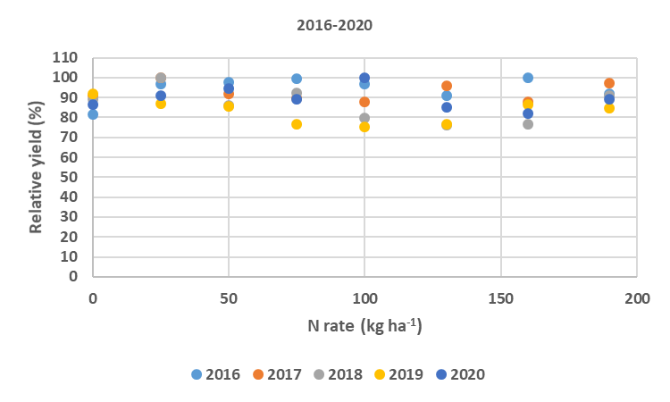
Relative yield- wheat after medics

Slide 16
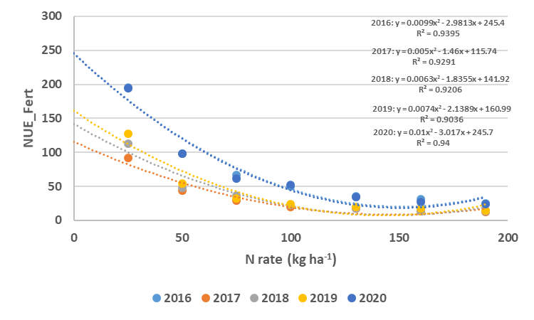
NUE- kg grain per kg N fertiliser wheat after medics

Slide 17
N response curve

Slide 18
Fertiliser sources- wheat after medics

Slide 19
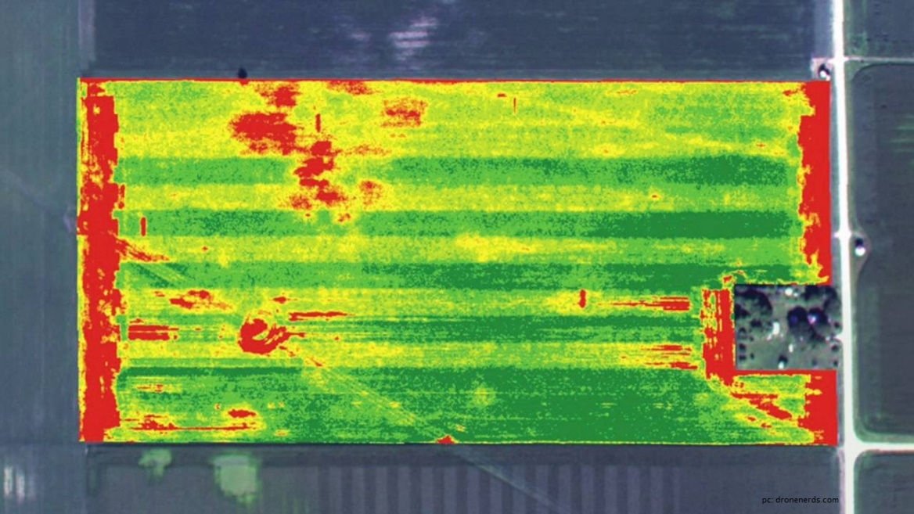
Results
Rainfall & distribution largest contributors to yield
Find the best practice for the specific site
Next: SPAD readings correlation NDVI sensors
N₂O monitoring

Slide 20
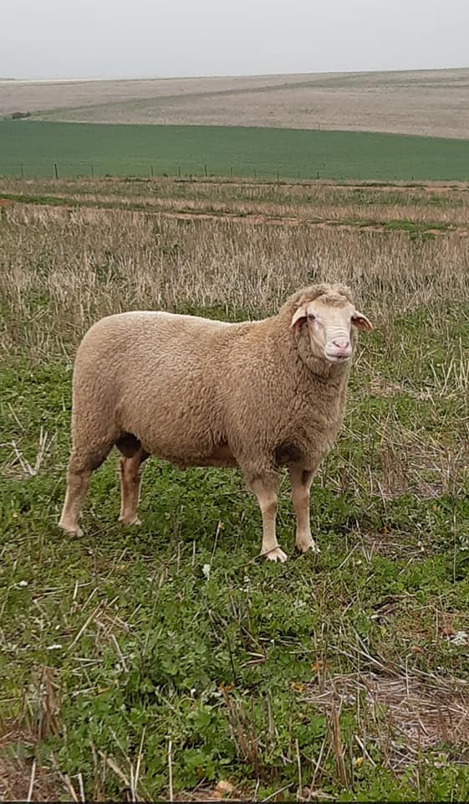
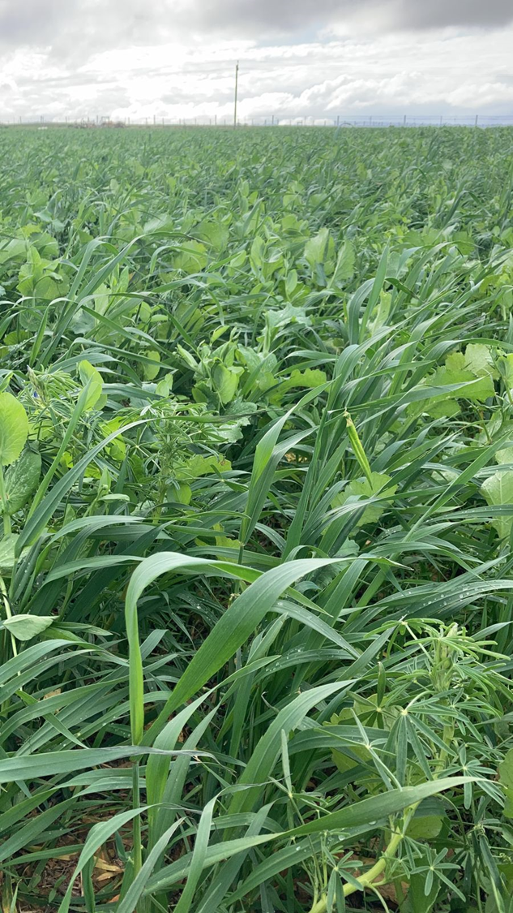
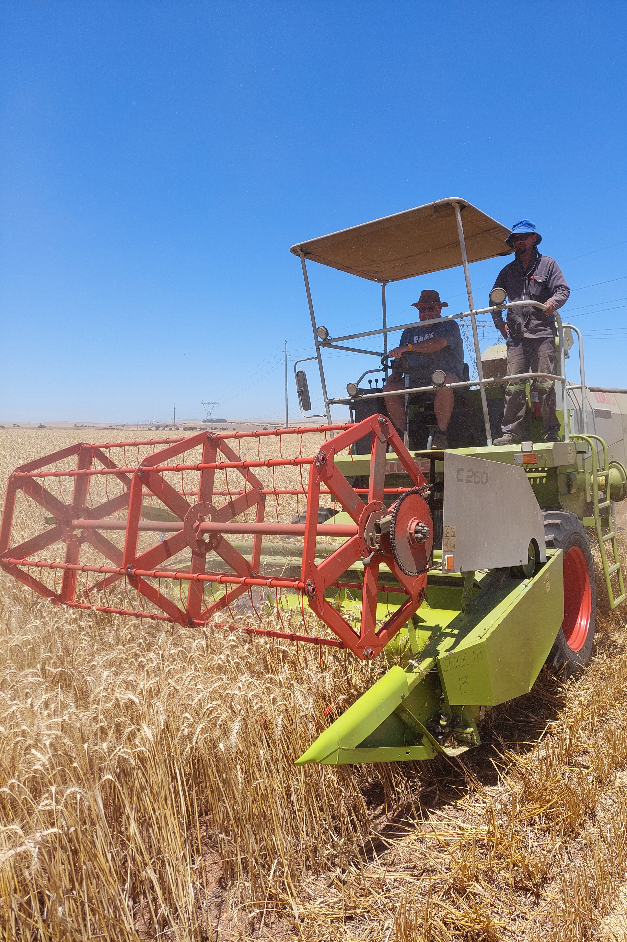
Trial 2: Systems Trial, Langgewens Research Farm

Slide 21



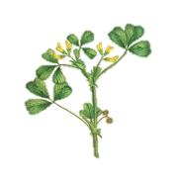






Trial layout & Nitrogen applications
System | Nitrogen application (kg/ha)
 | 2002-2021 | 2016-2021
A | 79 | 61
B | 81 | 65
C | 73 | 59
D | 81 | 65
E | 54 | 33
F | 54 | 35
G | 54 | 35
H | 54 | 33
A
B
C
D
E
F
G
H

Slide 22
Average wheat yield and protein content (2002-2021)

Slide 23
Wheat yield and protein content
  Significant interaction between cropping system and years

Slide 24
Yield system comparison biplot (Total – 90.23%)
A
B
C
D
E
F
G
H
PC2 – 9.44%
PC1 – 80.79%
x Genotype score (System)
+ Environment score (Years)
o AEC

Slide 25
Protein system comparison biplot (Total – 94.09%)
A
B
C
D
E
F
G
H
PC2 – 5.75%
PC1 – 88.33%
x Genotype score (System)
+ Environment score (Years)
o AEC

Slide 26
Results
The difference in systems is greater than the difference between the years.
2017(dry) is closer to 2021(wet), compared to System A and G.
An unsustainable system is worse than a yearly drought.

Slide 27
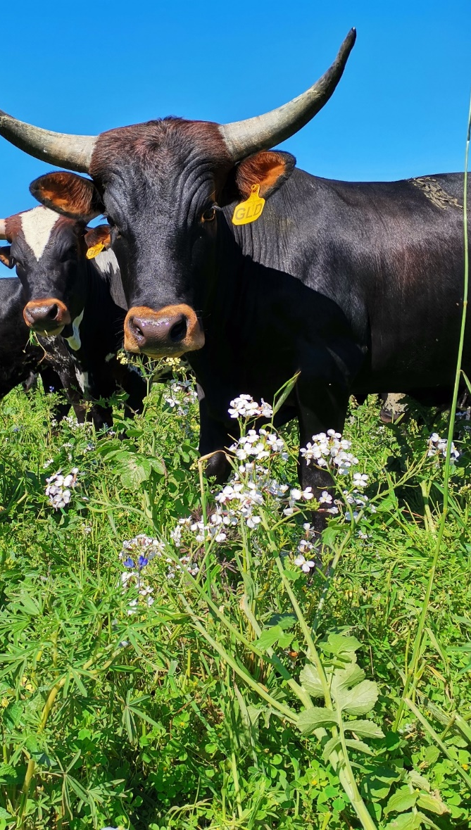
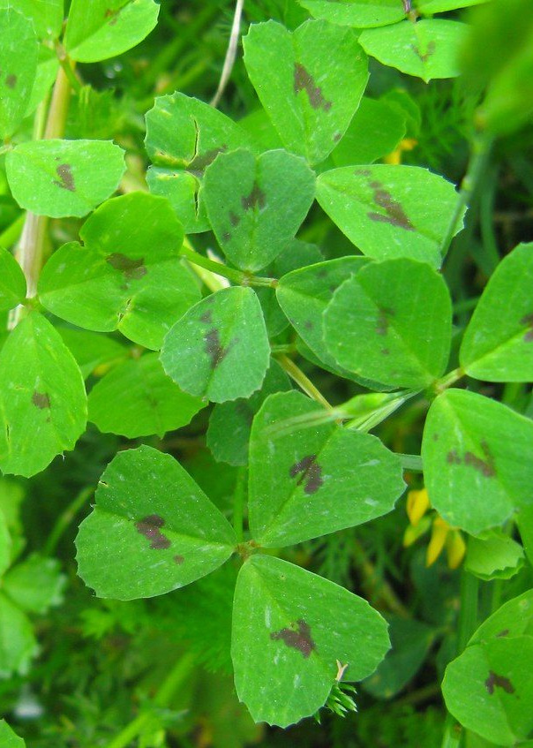
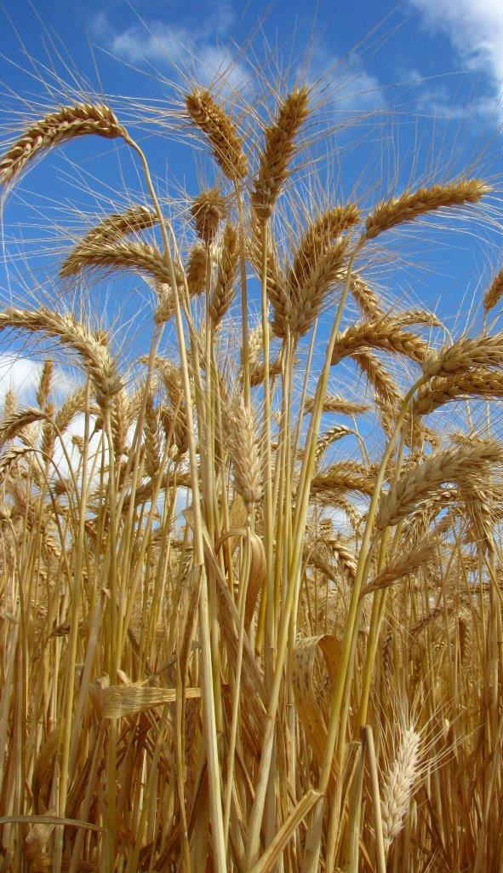
Farmer’s perspective

Slide 28
Uitkyk Boerdery, Moorreesburg -1971
25 years of monoculture
2.7 ton ha⁻¹ wheat
¹/₃ fallow
Burn stubble
120 kg N & 20 kg P ha⁻¹spread out

Slide 29
Uitkyk Boerdery, Moorreesburg -1997
Free market system 1997
Cash crops-canola, lupines
80 kg N & 20 kg P ha⁻¹spread out
Topdressing 20 or 40 kg ha⁻¹ N according to rainfall
2 ton lime applied every 4 years
Soil inverted and worked with tine
pH(KCl)= 5

Slide 30
Uitkyk Boerdery, Moorreesburg -2000
Planted 1st medics
N fertiliser decreased to 60 kg ha⁻¹
2 ha grid soil sampling
Lime and gypsum variable application
Ca: Mg-ratio, pH(KCl) =6
Can farm with less N, because the system is more efficient

Slide 31
Uitkyk Boerdery, Moorreesburg -2010
modern ¹/₃ system
The 1st year of medics, no herbicide, sow in radish, Saia oats, rye- soil structure
2nd year clean medics, N factory
The protein was not always high enough
Micronutrients essential, soil C, K
Animals manure-positive effect

Slide 32
Soil analysis

Slide 33
Uitkyk Boerdery, Moorreesburg -2021
9 kg N/ha chicken manure pellets with added chemicals
No topdressing
13% protein, 3 ton/ha wheat
0 N blocks 2.7 ton/ha wheat
Planting density 150 seeds/m², norm 200 seeds/m²
After planting, 50-60 mm rain
Less 600 mg ha⁻¹ Ca + N
900 mg kg⁻¹ Ca, after 2 years of medics, no extra N fertiliser
Insect pressure and powdery mildew less

Slide 34
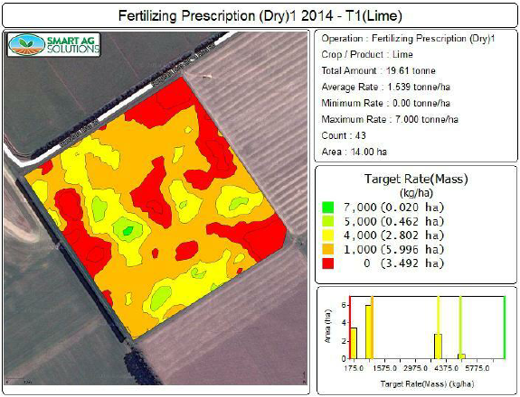
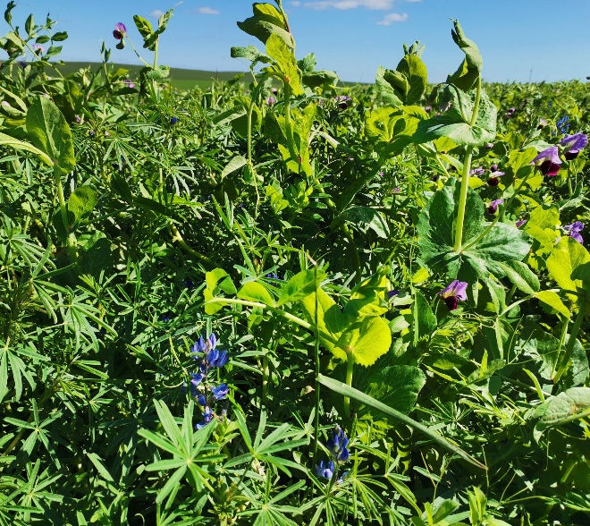
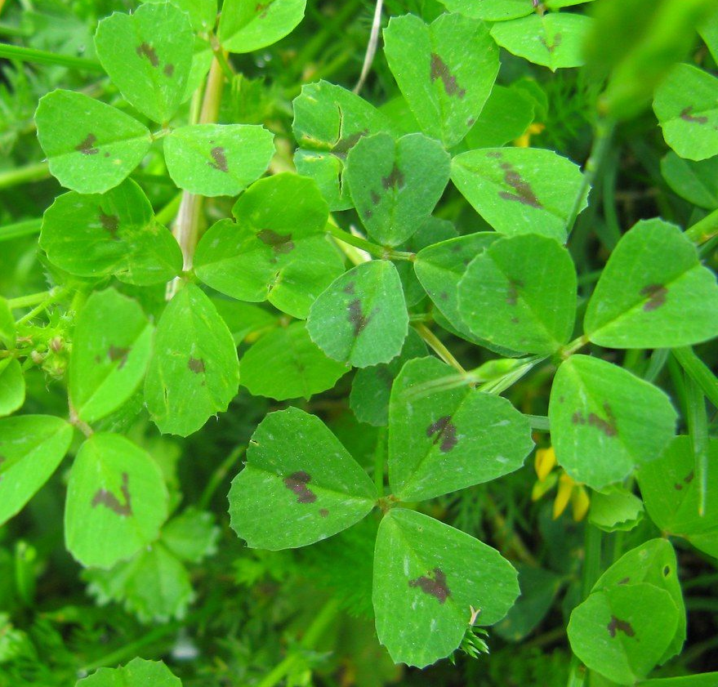
Conclusions
  Goal to increase NUE within changing climate
  Increase soil’s capacity to act as a net N sink with the addition of C inputs
  Stable high yields and quality under variable climatic conditions
  Future: Soil microbial analysis & biostimulants

Slide 35
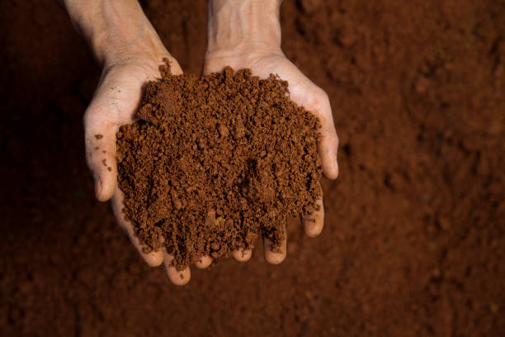
‘
Upon this handful of soil our survival depends. Nurture it and it will grow our food, our fuel and our shelter and surround us with beauty. Abuse it and the soil will collapse and die, taking humanity with it.” Sanskrit text-1500 BC

