Slide 1

Developing novel fertilisers to optimise crop nutrition and minimise environmental footprint
Mike McLaughlin
Fertiliser Technology Research Centre
The University of Adelaide, Australia

Slide 2
Novel fertilisers – common key objectives
Improve nutrient acquisition by plants
Reduce non-productive losses of nutrients to the atmosphere or waters
Reduce long-term storage of nutrients in soil
Improve human and/or animal nutrition
Reduce nutrient cost
Simplify fertilizer manufacturing
Reduce energy use or waste emissions during fertilizer manufacturing

Slide 3
Novel fertilisers – improving agronomic efficiency
Some nutrients are easily lost to the atmosphere – e.g. nitrogen (N)
Some nutrients can be “tied up” or stored in soils – phosphorus (P), copper (Cu), manganese (Mn), zinc (Zn)
Some nutrients are easily leached from soils
  Acidic soils – N, sulfur (S), boron (B) and sometimes calcium (Ca)/magnesium (Mg)
  Alkaline soils - N, S, molybdenum (Mo) and selenium (Se)

Slide 4
Novel fertilisers
Phosphorus

Slide 5
Novel fertilisers – phosphorus fate in soil
Inefficiency terms
Erosion
Leaching/runoff
Occlusion in OM?
Strong sorption or ppt
Losses
Fertiliser P
Plant
P
Storage
Microbial
P
1
Soil
soln
2
Inorganic
P
Organic
P
2
4
3

Slide 6
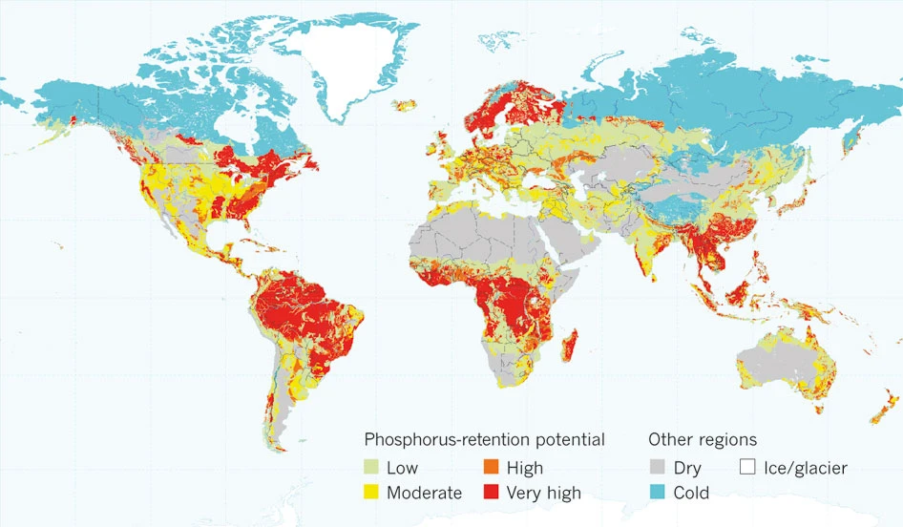
Novel fertilisers – P retention in soils globally
Kochian LV (2012) Rooting for more phosphorus. Nature 488: 466-467. doi: 10.1038/488466a.

Slide 7
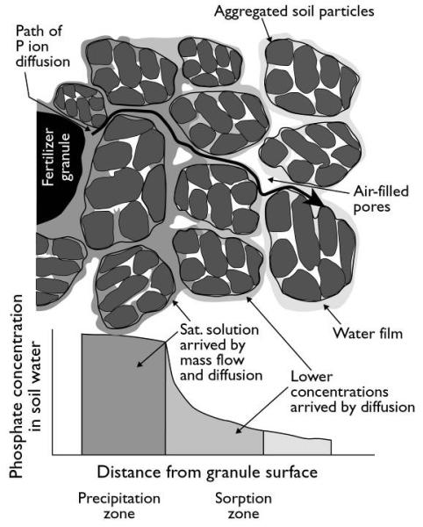
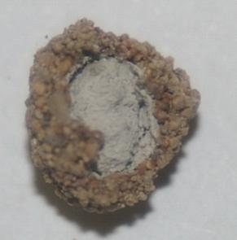
Increasing P efficiency – reducing precipitation of Ca-P
On addition to soil, fertilizer granules absorb soil solution
In calcareous soils, the soil solution is saturated with Ca²⁺
Incoming Ca meets outgoing P, and Ca-P precipitates
H₂O + Ca
P
Hedley M., McLaughlin M. (2005) Reactions of phosphate fertilizers and by-products in soils, in: J. T. Sims and A. N. Sharpley (Eds.), Phosphorus: Agriculture and the Environment, Agronomy Monograph no. 46, ASA/CSSA/SSSA, Madison, WI, USA. pp. 181-252.

Slide 8
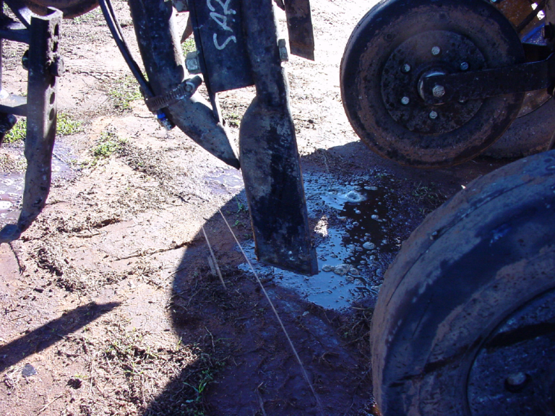
Increasing P efficiency – reducing precipitation of Ca-P
Common ion – adding excess sulfate (Olatuyi et al. 2010) to reduce Ca²⁺ activities and stimulate P release or minimise precipitation (c.f. Olsen/Colwell reagent, HCO₃⁻ ion)
Other anions could disrupt P precipitation but large amounts added to fertilizer will dilute nutrient content
Changing physical form of P applied to reduce precipitation reactions - addition of P as a fluid to calcareous soils avoids these precipitation reactions
Olatuyi, S. O., O. O. Akinremi, D. N. Flaten and G. H. Crow (2009). "Solubility and transport of phosphate and the accompanying ions as influenced by sulphate salts in a model calcareous soil system." Canadian Journal of Soil Science 89(5): 589-601.

Slide 9
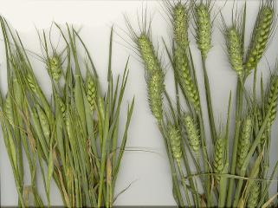
High efficiency of fluid P fertiliser in calcareous soils
Dry weight kg/ha
800
,
,
Fluid
,
,
,
,
600
,
,
400
Granular
,
'
'
'
'
'
'
Granular
200
'
'
'
'
'
'
'
Fluid
,
'
,
Fluid P, N, Zn
'
Granular MAP, dissolved Zn
0
0
20
40
60
P Rate kg P/ha
Holloway R.E., Bertrand I., Frischke A.J., Brace D.M., McLaughlin M.J., Sheppard W. (2001) Improving fertiliser efficiency on calcareous and alkaline soils with fluid sources of P, N and Zn. Plant and Soil 236:209-219.

Slide 10
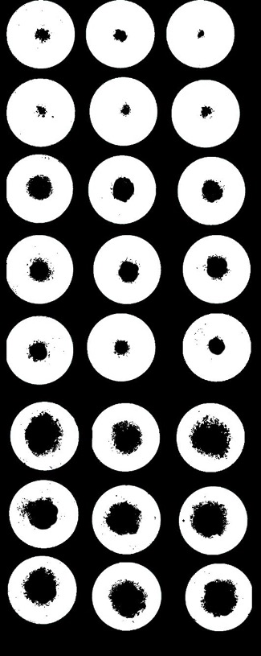
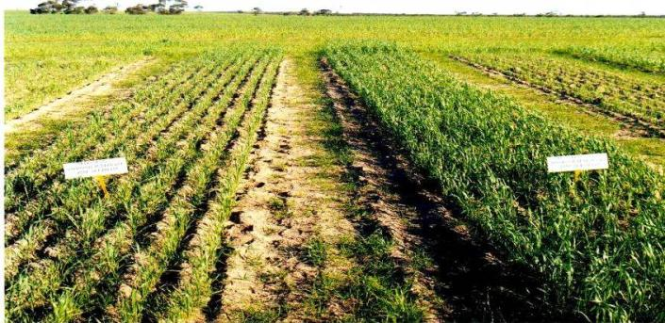
Increasing P efficiency – reducing precipitation of Ca-P
Fluid fertilizers highly effective on calcareous soils
Calcarosol
Granular P+TE
Fluid P+TE
SSP
TSP
MAP
DAP
MES10
flMAP 200μl
flMAP
100μl
APP

Slide 11
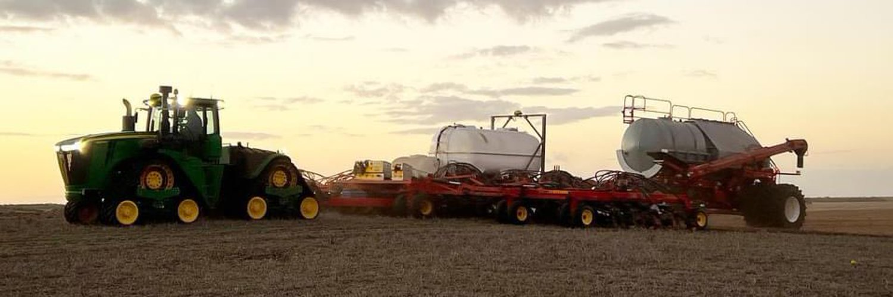
Increasing P efficiency – fluid P now used on calc. soils
Photo: Andrew Polkinghorne

Slide 12
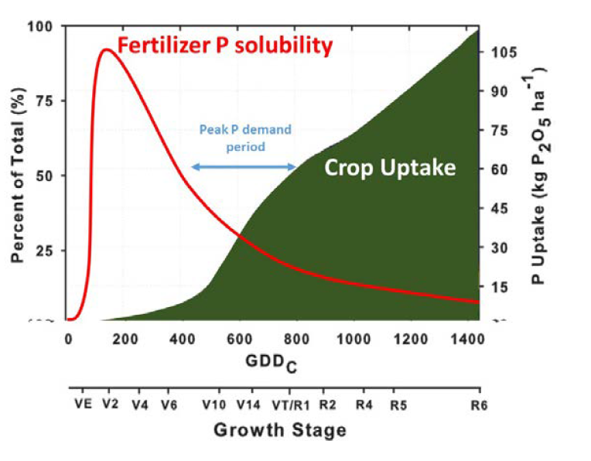
Synchronising fertiliser P release with plant demand
Water-soluble P from soluble P fertilizers (MAP, DAP, TSP etc) is quickly released in soil - less than 24 h after placement in moist soil.
However, crop peak P demand (crop and climate dependent) occurs later:
“Mismatched P” may result in losses, through runoff, leaching (in sandy soils) and
  adsorption or precipitation of P to less available forms
High demand
Conceptual diagram of P release from water-soluble fertilizer and P uptake (hybrid corn, adapted from Bender et al. 2013)

Slide 13
Synchronising fertiliser P release with plant demand
Dual-release
P

Slide 14
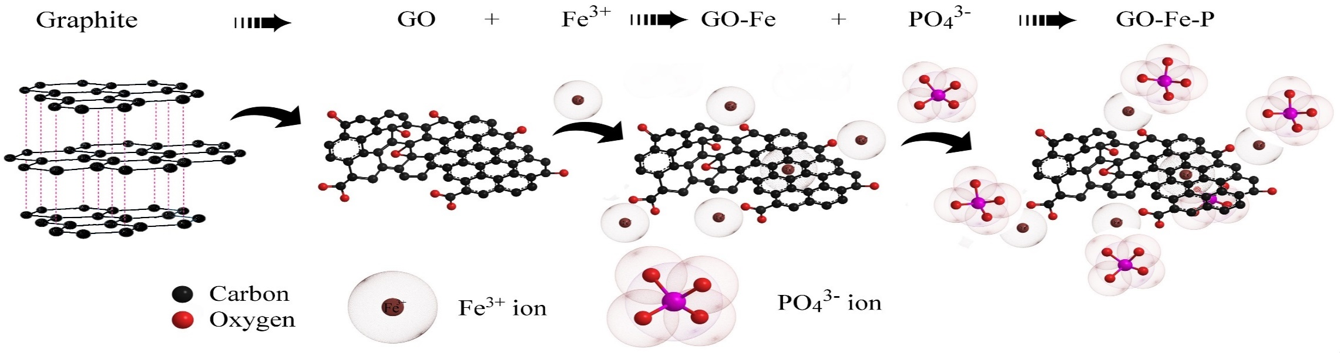
Dual-release P – graphene composites
Graphene first oxidised to graphene oxide (GO) – a highly reactive form of graphene
Fe³⁺ was loaded onto the GO to form a GO-Fe composite
Phosphate was loaded onto the GO-Fe composite to form a mixed Go-Fe-P composite granule
Andelkovic, I. B., Kabiri, S., da Silva, R. C., Tavakkoli, E., Kirby, J. K., Losic, D., and McLaughlin, M. J. (2019). Optimisation of phosphate loading on graphene oxide-Fe(III) composites - possibilities for engineering slow release fertilisers. New Journal of Chemistry 43, 8580-8589.

Slide 15
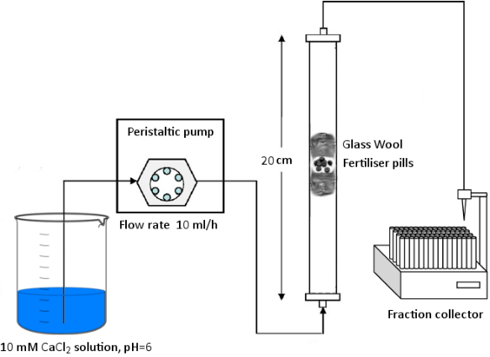
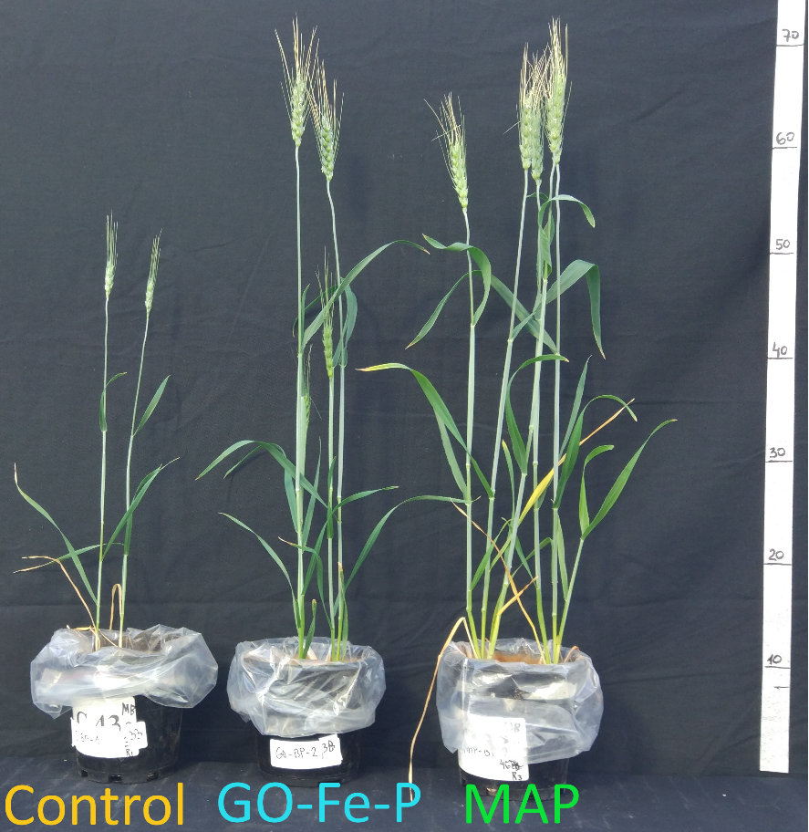
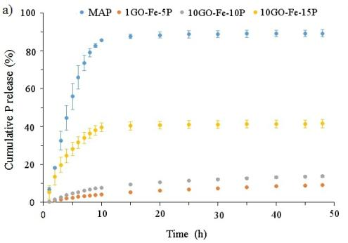
Controlled release P and crop response – graphene composites composites
Andelkovic, I.B., Kabiri, S., Tavakkoli, E., Kirby, J.K., McLaughlin, M.J., Losic, D., 2018. Graphene oxide-Fe(III) composite containing phosphate – A novel slow release fertilizer for improved agriculture management. Journal of Cleaner Production 185, 97-104.
Dual-release properties
Andelkovic, I. B., Kabiri, S., da Silva, R. C., Tavakkoli, E., Kirby, J. K., Losic, D., and McLaughlin, M. J. (2019). Optimisation of phosphate loading on graphene oxide-Fe(III) composites - possibilities for engineering slow-release fertilisers. New Journal of Chemistry 43, 8580-8589.

Slide 16

Can we reduce P fixation in soil to increase P use efficiency?
Unsuccessful (to date)…..
And often you don’t really need to!

Slide 17
Novel fertilisers
Sulfur

Slide 18
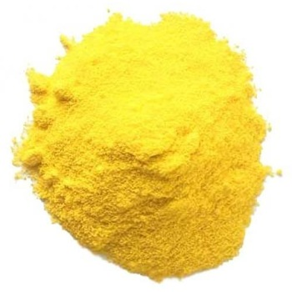


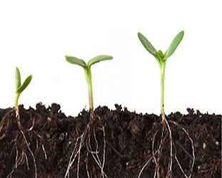

Improving elemental S-based fertilisers
Elemental sulfur is an effective way to provide S to crops, providing the S⁰ oxidises quickly to sulfate-S in soil (plants cannot take up elemental S)
Elemental sulfur
S⁰
Elemental S is effective as you do not “waste molecular room” in the fertiliser with “useless” oxygen atoms – we can let soil microorganisms (not just Thiobacillus!) add the O atoms after fertilisation
S⁰ = 32 g/mole
SO₄ = 96 g/mole
Zhao C, Gupta VVSR, Degryse F, McLaughlin MJ (2017) Abundance and diversity of sulphur-oxidising bacteria and their role in oxidising elemental sulphur in cropping soils. Biol Fert Soils 53: 159-169.
doi: 10.1007/s00374-016-1162-0.
SO₄

Slide 19
Elemental S oxidation in soils
Elemental S increasingly added within other fertilisers (N, P), but S supply in soil is sometimes too slow in these for early crop demand and there is a “lag phase” before sulfur oxidation starts
Oxidation of elemental S limited by its “effective surface area” – this decreases as you try to add more elemental S particles to the fertiliser granule
ES particles
Macronutrient carrier
Degryse F, da Silva RC, Baird R, McLaughlin MJ (2016) Effect of cogranulation on oxidation of elemental sulfur: Theoretical model and experimental validation. Soil Sci Soc Am J 80 (5):1244-1253. doi:10.2136/sssaj2016.02.0054

Slide 20
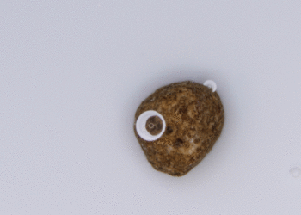
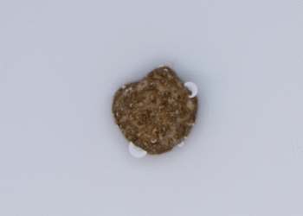
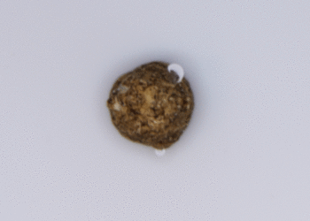
Increasing oxidation of elemental S in granules
Can we somehow increase the effective surface area of the elemental S in granules after addition to soil to expose them to microbial colonisation?
Disintegration in water (15 minutes)
Formulation 1
Formulation 2
Control
www.mlive.com

Slide 21
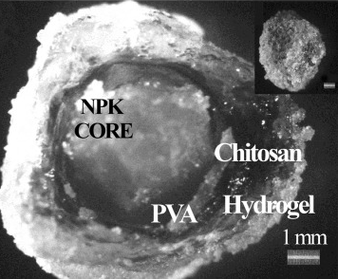
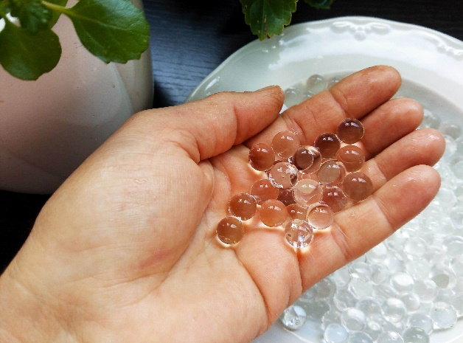
Using hydrogels in fertilisers
What are hydrogels? Hydrogels are cross-linked polymers with an ability to absorb large quantities of water
A variety of natural and synthetic polymers can be produced to develop a hydrogel – polyacrylamide, alginates, gums, starches, chitosan, etc.
Hydrogel coatings have traditionally been investigated to retain water in the root zone and to slow nutrient release from granular macronutrient fertilisers in coatings
However, they may also be used to increase microbial oxidation of elemental S
Noppakundilograt et al. (2015)
news.engine.umich.edu
Noppakundilograt, S., Pheatcharat, N., and Kiatkamjornwong, S. (2015). Multilayer-coated NPK compound fertilizer hydrogel with controlled nutrient release and water absorbency. Journal of Applied Polymer Science 132, 41249 1-11).

Slide 22
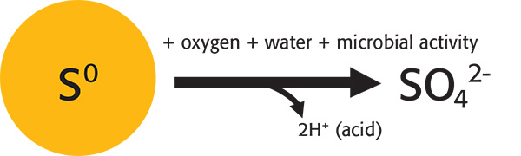
Effects of hydrogels on oxidation of elemental S
80
Control granules
70
+ Hydrogel 1
60
+ Hydrogel 2
50
Elemental S oxidised (%)
Oxidation rate of elemental S can be “tuned’ with hydrogel inclusion
40
30
20
10
0
0
10
20
30
40
50
60
Time (d)

Slide 23
Novel fertilisers
Boron

Slide 24
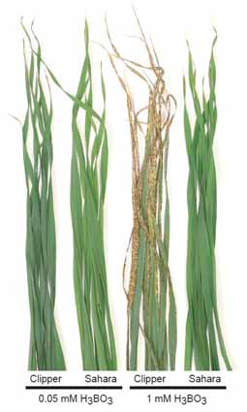
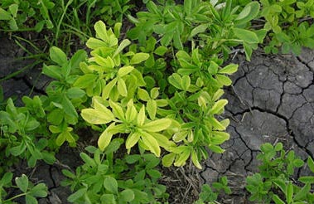
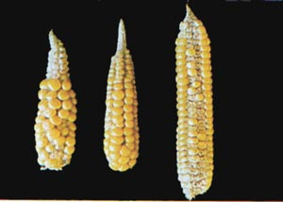
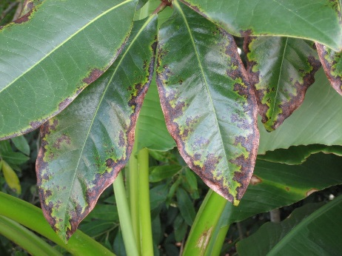
Boron toxicity and deficiency in plants
Boron is an essential micronutrient required for several functions in plants, but may also be toxic at high concentrations
B deficiency
B toxicity
www.pioneer.com
Gupta,` U. C., et al. (1985). "Boron toxicity and deficiency : A review." Canadian Journal of Soil Science 65(3): 381-409.
http://aesl.ces.uga.edu/DiagnosticsII/
www.acpfg.com.au

Slide 25
Plant demand for boron during growth
While essential for early root growth, B is also required by plants later in the growth cycle to assist with flowering and reproduction
Bender, R. R., et al. (2013). "Nutrient uptake, partitioning, and remobilization in modern, transgenic insect-protected maize hybrids." Agronomy Journal 105(1): 161-170.

Slide 26
Boron fertilisation
Recommended rates depend on B crop requirements but are generally less than 10 kg/ha per annum
Methods of application
  Soil application: Soluble (borates) or sparingly soluble B sources (colemanite/ulexite)
  Foliar for selected crops to ensure B supply at flowering (extra labour/fuel required)
For soil-applied B fertilizer we should aim to:
  Preferably apply at same time as macronutrients (co-granulate or blend) – pre-plant
  Provide soluble B initially but also ensure supply later in the season
  Reduce risk of seedling toxicity

Slide 27
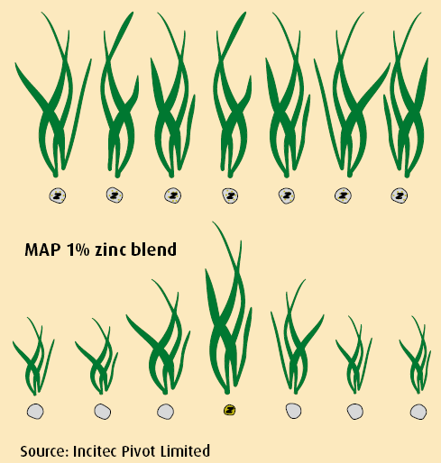
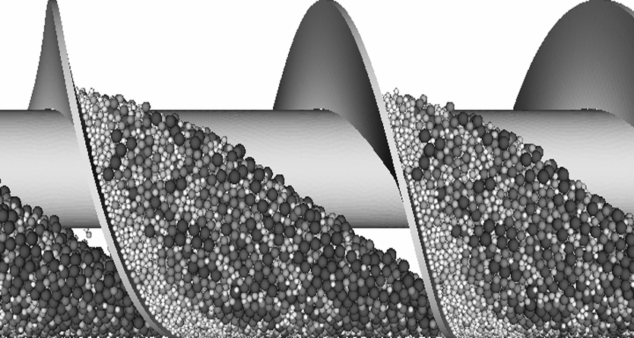
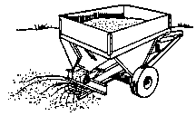
Boron fertilisation
Bulk blends of B sources with macronutrients can suffer from segregation during transport and application
Bulk blends also suffer from heterogenous nutrient distribution in the field
Co-granulated
Bulk blend

Slide 28
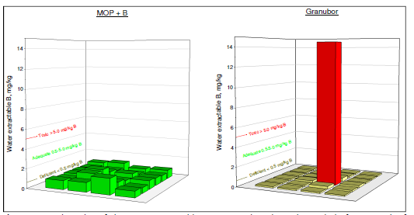
Boron fertilisation – toxicity of bulk blends
Soluble B-only fertilisers risk seedling toxicity in bulk blends around the B source
Sparingly soluble B sources (colemanite, ulexite) risk poor B supply early in the season
Co-granulated product
Bulk blend
da Silva, R. C., et al. (2018). "Slow and fast-release boron sources in potash fertilizers: Spatial variability, nutrient dissolution and plant uptake." Soil Science Society of America Journal 82(6): 1437-1448.

Slide 29
Boron fertilisation – dual B supply
Ideal B supply
Aims
Soluble source
Less-soluble source
Develop dual-release B-enriched macronutrient fertilisers to match plant demand
Use low cost less-soluble B sources
Reduce risk of seedling toxicity
Reduced seedling toxicity
Season-long B supply

Slide 30
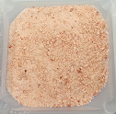
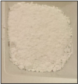
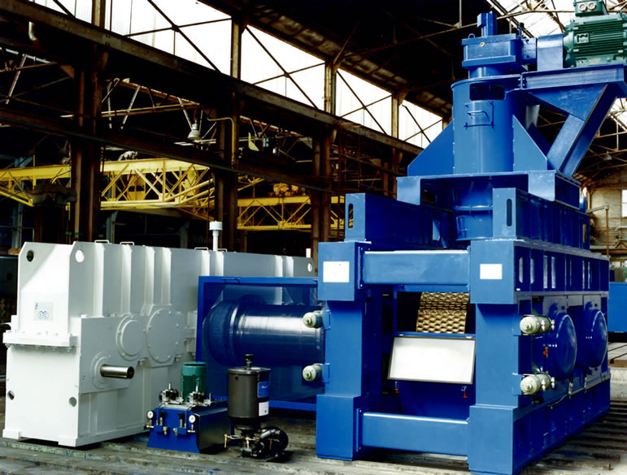
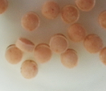
Manufacture of MOP-based boronated fertilisers
Compaction
+
MOP
B source
www.feeco.com
Abat M, Degryse F, Baird R, McLaughlin MJ. 2014. Formulation, synthesis and characterization of boron phosphate (BPO₄) compounds as raw materials to develop slow-release boron fertilizers. Journal of Plant Nutrition and Soil Science 177:860-868.

Slide 31
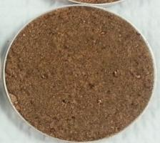
Manufacture of MOP-based boronated fertilisers
15
7.5
Boronated MOP granule
e
Abat M, Degryse F, Baird R, McLaughlin MJ. 2015. Boron phosphates (BPO₄) as a seedling-safe boron fertilizer source. Plant and Soil 391:153-160.
e
Ulexite still too soluble
Colemanite less soluble

Slide 32
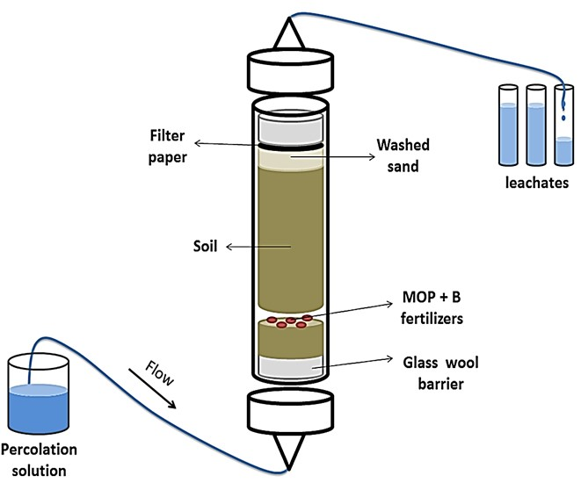
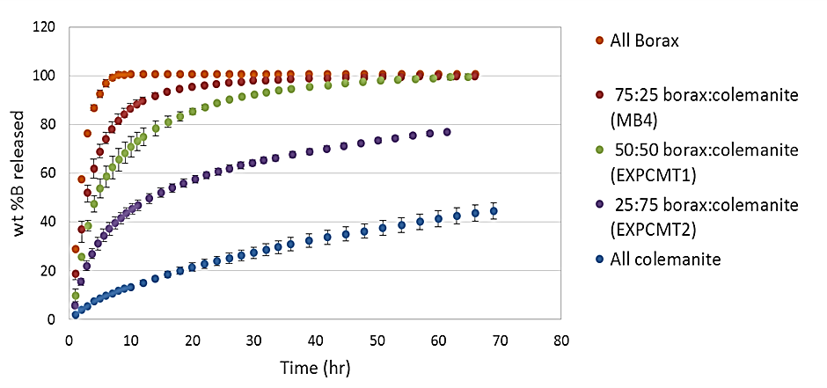
Release kinetics of B from boronated MOP
Boron release kinetics can be “tailored” using different proportions of borax and colemanite in the MOP matrix

Slide 33

Dual release boronated MOP – plant B uptake after leaching
Pot trial with canola and boronated MOP fertilizer, in non-leached or leached (4 pore volumes) pots
Unleached pots
Leached pots
da Silva, R. C., et al. (2018). "Slow and fast-release boron sources in potash fertilizers: Spatial variability, nutrient dissolution and plant uptake." Soil Science Society of America Journal 82(6): 1437-1448.

Slide 34
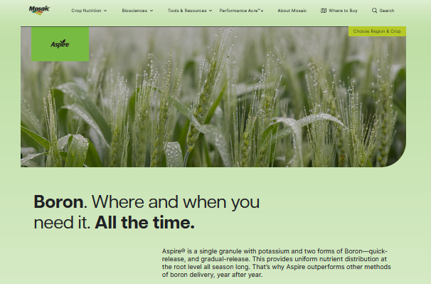
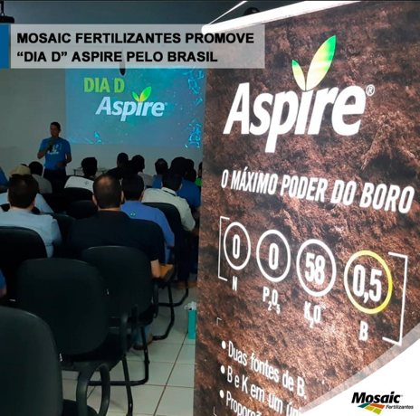
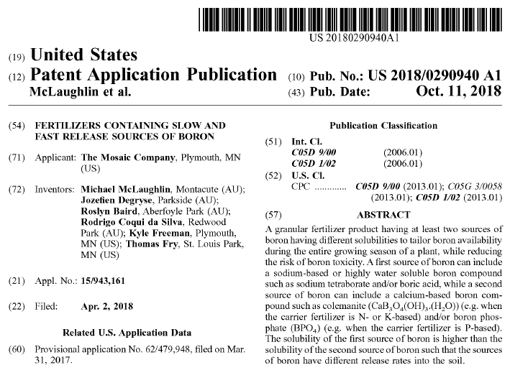


Commercial product now marketed by Mosaic LLC
15
7.5
e
e

Slide 35
Other slow-release B sources
15
7.5
Multi-micronutrient fertilisers are more likely to meet plant nutritional requirements than single micronutrient products
Can we enhance boronated macronutrient fertilisers to match plant requirements by including zinc?
Could sparingly soluble zinc borates be used as B fertiliser sources for boronated macronutrient formulations?
Could we manufacture zinc borates using mechanochemical methods?
e
e

Slide 36
Zinc borates
There are several different chemical forms of zinc borate that vary in the ratio of Zn:B and in water solubility
Zinc borates are widely used commercially as flame retardants and in paints and textiles – usually made from pure Zn and B compounds
We examined
    Commercial zinc borates – manufactured by wet chemical or hydrothermal methods
    Mechanochemically synthesised zinc borates – “green” synthesis
15
7.5
aZnO.bB₂O₃.cH₂O
e
e

Slide 37
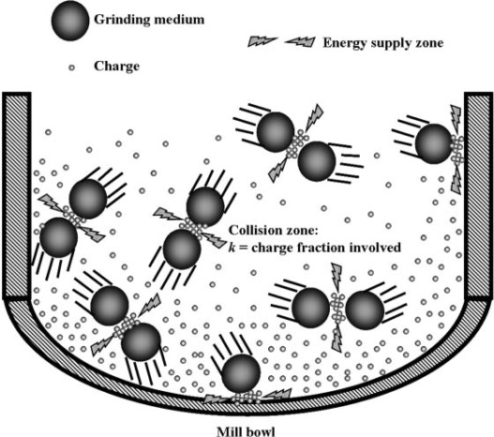
Mechanochemistry – advantages
No liquid waste streams
No co-product generation
Less energy required
Ambient temperatures generally used
Rapid

Slide 38
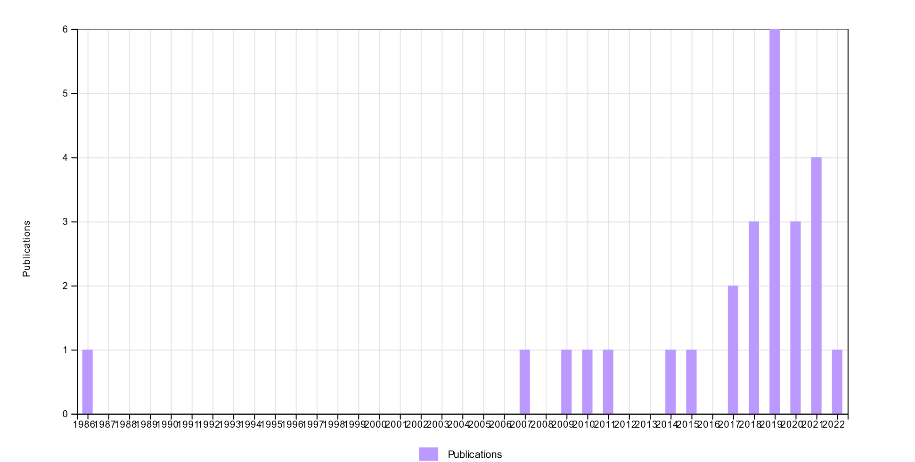
A new field - search “mechanochem*” and “fertilizer”/”fertiliser”
26 scientific publications only since 1986

Slide 39
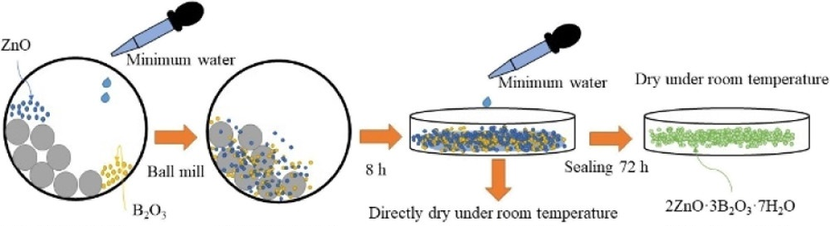
Mechanochemical synthesis of zinc borates
15
7.5
e
e
Decreasing B solubility
Zheng, B., et al. (2021). "Mechanochemical Synthesis of Zinc Borate for Use as a Dual-Release B Fertilizer." ACS Sustainable Chemistry & Engineering 9(47): 15995-16004.

Slide 40
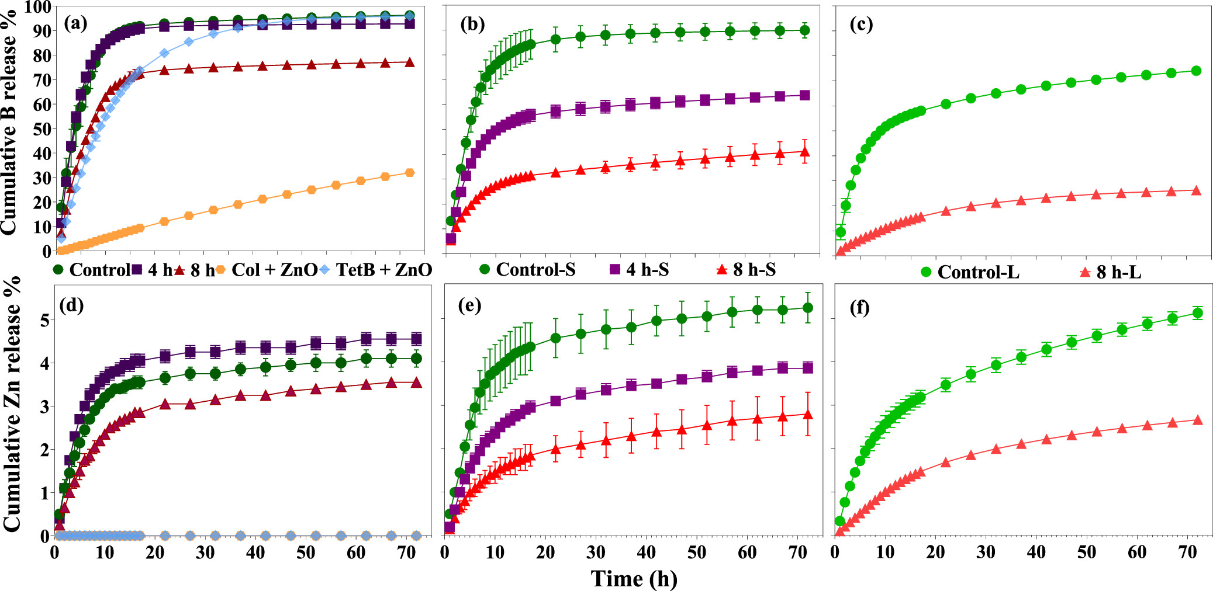
Mechanochemically synthesised zinc borates
Mechanochemical treatment with zinc oxide successfully reduced the solubility of anhydrous boron by forming zinc borate - 2ZnO·3B₂O₃·7H₂O
Solubility could be controlled by changing milling time and amount of water-assisted reaction (WAR)
15
7.5
e
Increasing milling time
Increasing
milling time
e
Increasing WAR
Zheng, B., et al. (2021). "Mechanochemical Synthesis of Zinc Borate for Use as a Dual-Release B Fertilizer." ACS Sustainable Chemistry & Engineering 9(47): 15995-16004.

Slide 41
Conclusions/Summary
We need to re-design fertilisers to more closely match plant demand for nutrients (amounts, stoichiometry and timing of release)
We also need to develop more “green” manufacturing methods for fertilisers with less carbon footprint and minimal waste streams
New materials and new chemical/biochemical techniques offer several possibilities to transform fertiliser manufacturing
At the same time, simple combinations of traditional nutrient sources can improve crop nutrient uptake and minimise losses to the environment

Slide 42

Acknowledgments
Fien Degryse
Roslyn Baird
Ivan Andelkovic
Rodrigo Coqui da Silva
Margaret Abat
Bo Zheng
Bogumila Tomczak
Colin Rivers
Ashleigh Broadbent
Andrea Paparella
Thanks to FertASA for the invitation!

